Slide 1
AIC Project Ideas
Christian Koehler, Nam Ho Koh - AIC

Slide 2
Introduction
The scenarios in this deck were developed as exploration of potential future UI alternatives and use cases
They broadly fall in the realm of Futurology (https://en.wikipedia.org/wiki/Futures_studies) and are meant to explore a near-future when wearable AR technology is ubiquitous
The base scenario imagines that current mobile phones are replaced with wearable AR solutions
Our competitors are heavily investing in wearable AR/VR technology
https://www.macrumors.com/2020/05/14/apple-acquires-nextvr/
https://www.macrumors.com/2020/05/14/kuo-apple-glasses-2022-new-ipads-2020/
https://www.google.com/glass/start/

Slide 3
Beyond Touch UI
Home + Mobile

Slide 4
Introduction
Traditional user interaction heavily relies on touch:
We produce text with physical keyboards
Interact with buttons and controls in our environment
Use touch screens on various devices to control them
BUT: touch-based interfaces such as mobile phones are an active vector for virus transmission¹
Beyond current situation, some users have trouble interacting with touch interfaces due to illness, disability, or age
For example, over 22% of the U.S. adult population have some form of arthritis (see (2) that limits their ability to interact using touch
How can we create a flexible framework for enabling user interaction with devices and the environment that goes beyond traditional touch interfaces?
https://time.com/4908654/cell-phone-bacteria/
https://www.cdc.gov/arthritis/data_statistics/arthritis-related-stats.htm

Slide 5
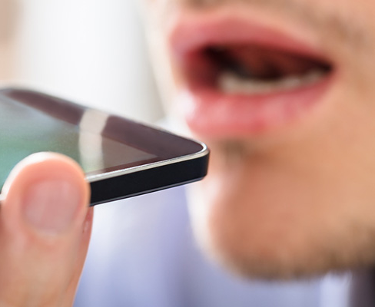
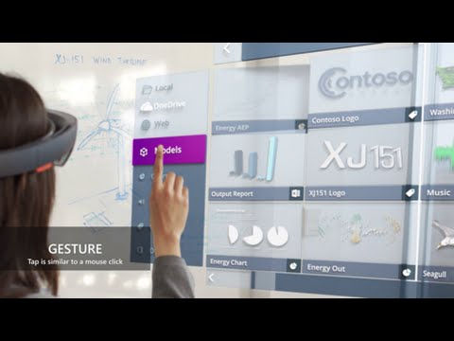
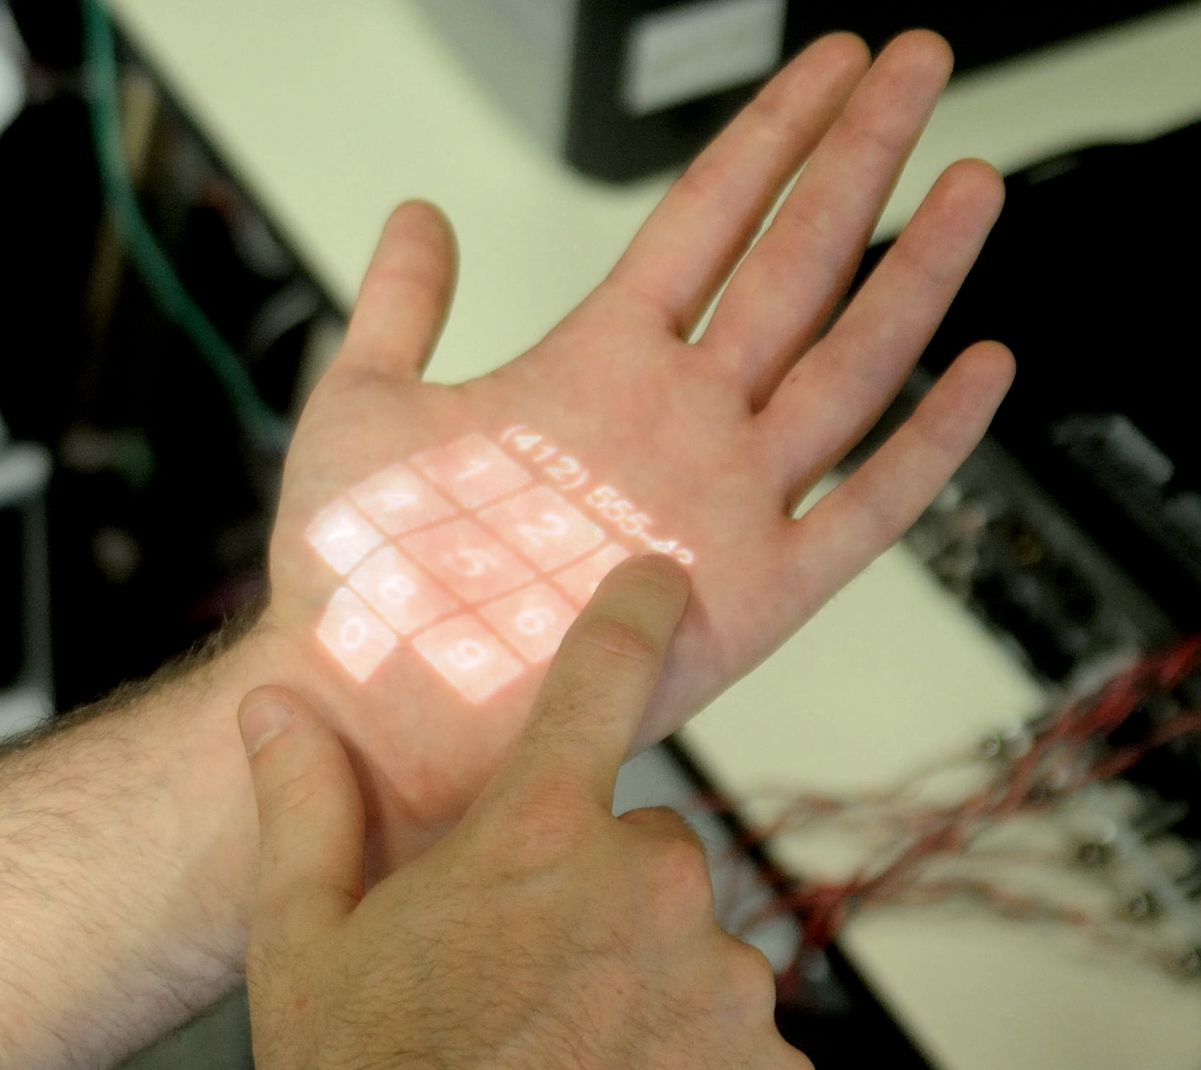
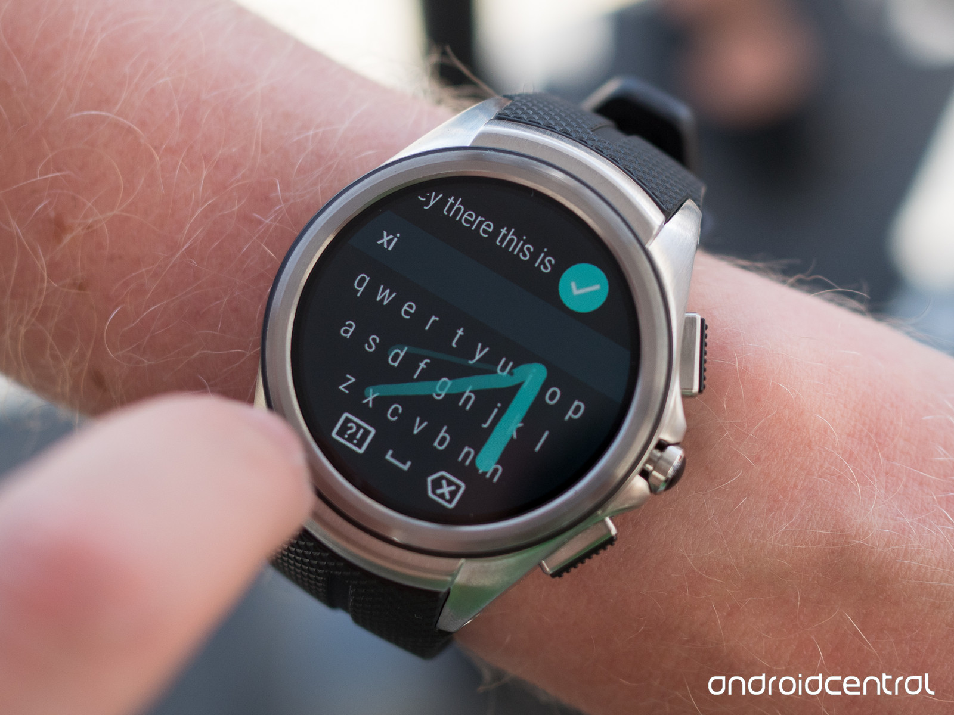
Interaction Modalities Beyond Traditional Touch Interfaces
Voice Input
Gesture Input
Alternative UIs
(e.g. Skinput)
Watch Input

Slide 6
Voice as universal input
Enable deep control of device using voice by integrating with underlying OS (e.g., Android, Smart Things, etc.)
Advantages:
Depending on complexity of underlying system it can perform multiple chained UI interactions using one command
Enables identification of users
Can enable interactions without breaking current work flow
Disadvantages
Maturity of current technology
Not appropriate for all situations
Sensitive to surrounding conditions

Slide 7
Gesture Input for AR/VR
AR/VR systems enable interaction that go beyond current devices
As a companion to voice, gesture input can enable seamless interaction with virtual content
Advantages:
Paired with AR/VR gesture input can delivery layer of security
Enable interaction with visual input without need to touch anything
Disadvantages:
Meaningful gesture input needs to be tied to virtual display
Translating gesture to UI interactions challenging due to missing frame of reference
AR glasses available from multiple manufacturers:
https://www.google.com/glass/providers/
https://everysight.com/about-raptor/
https://www.vuzix.com/products/blade-smart-glasses

Slide 8
Interaction through wearable device
Wearable devices like smart watches have lower chance of being unsanitary since
they are kept on the body at all times
Rarely come into contact with contaminated surface areas
Can be used for a multitude of use cases from mobile payment over smart notifications to user input
Advantages:
Small formfactor that makes it ideal for quick interaction
Can be used as voice input device or for gesture recognition
Disadvantages:
Small screen size limits ability to output complex visual content

Slide 9
Novel Input Modalities
Go beyond current input modalities and enabled new interactions methods
For example:
Turning surfaces into touch enabled screens through projection
Create materials that are touch enable and can be body worn
Using human body as input device (e.g., Skinput)

Slide 10
AR/VR Glass Interaction Through Wearables
Home + Mobile

Slide 11
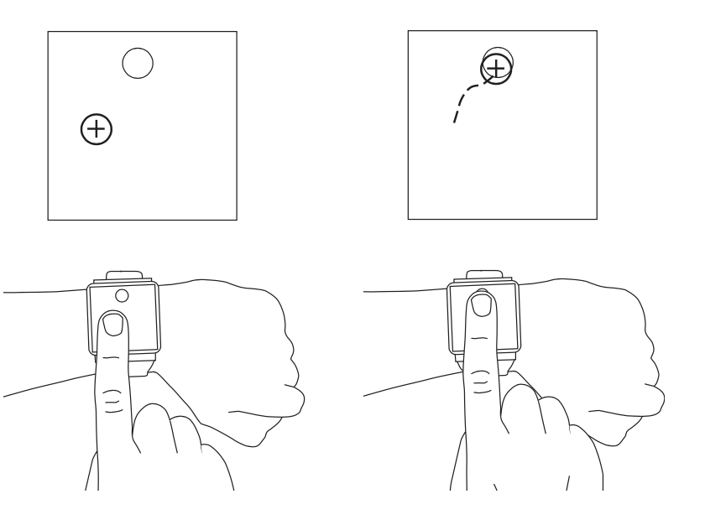
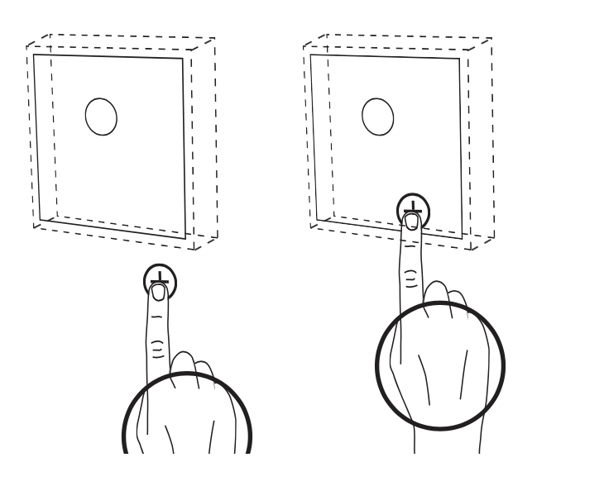
Introduction
Interacting with visual content on AR/VR glasses challenging due to missing direct pointing mechanism
Wearables like smart watches promising to bridge between virtual and physical world
Two possible approaches:
Enable interaction with visual content by turning smart watch into trackpad
Use motion sensor of watch to control in-air cursor
In combination with voice interface for text input this can remove the need for touch input

Slide 12
Virtual UIs for Physical Devices Using AR Glasses
Home + Mobile

Slide 13
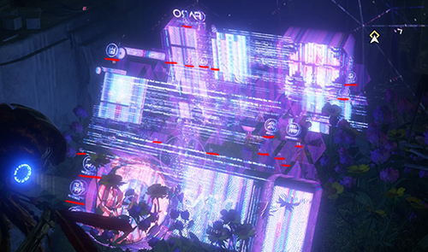
Future Exploration
Horizon Zero Dawn Video Game AR Control
Physical devices (e.g., washing machines, microwaves, etc.) have complex UIs to allow users access to the various functionalities of the device
Implementing those UIs is challenging for designers and require real estate on the device
Enable detailed control of physical devices by displaying user interface in AR

Slide 14
Advantages
Allows developers to realize complex UI that are not limited by physical space of the device
UIs adaptable to user needs (e.g., elderly users can have larger UI)
Virtual UIs can display additional information such as tool tips and explanations of functionality
User can retrieve information and control devices even in absence of physical screen or buttons, which enables a completely new class of products
Automatic translation of UIs into native language

Slide 15

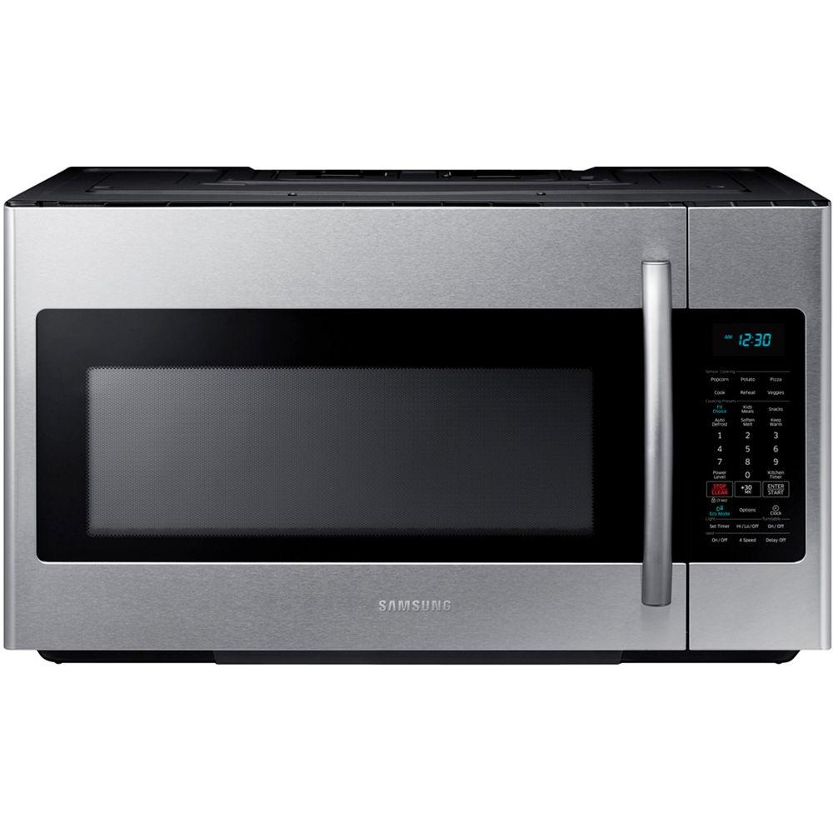
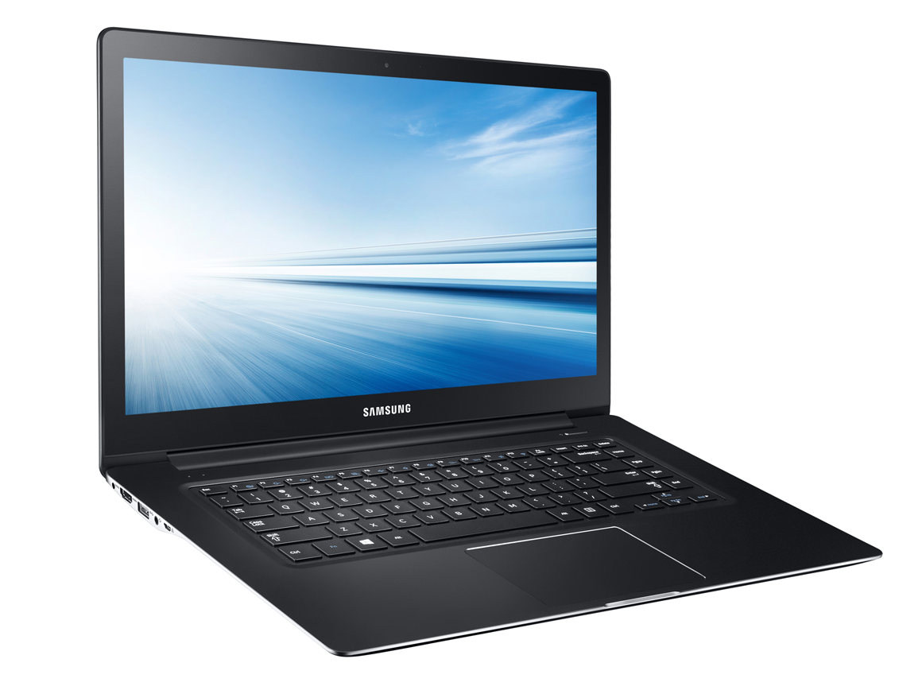
Usage Examples

Slide 16
UI Explanation for Physical Devices Using Voice and AR
Home + Mobile

Slide 17
Introduction
UIs for complex devices such as microwaves, ovens, or washing machines need to convey a lot of information on limited space
Users can have a tough time navigating such UIs (e.g., change the power level on a microwave)
AR + Voice offers an innovative solution by:
Allowing users to ask how to perform a specific task and
Highlighting and explaining physical UIs using AR explanations and highlights

Slide 18
Contextual AR+Voice Notifications
Home + Mobile

Slide 19
Introduction
Enable contextual AR notifications that show important information at the right time
Going beyond simple location based reminders
Include voice memos: people can leave voice recordings on objects
Examples:
User is about to leave home and get notification to pack their climbing shoes for a lunch data at the gym with their spouse
User enters Safeway and sees shopping list compiled by their loved one
User goes to the living room and upon looking at the elliptical sees pop-up telling him when and how much he last exercised; gets a reminder to exercise more
Wife leaves AR voice memo over trash can as a reminder to husband

Slide 20
Gamification of Chores Using AR
Home

Slide 21
Introduction
Turn regular chores such as vacuuming, dishwashing, gardening, etc. into (potentially collaborative) AR games
Motivate children to do chores in fun way
In households with multiple kids competition can even further motivate them
Examples:
Drying dishes: Kids see points above dishes that need drying and they receive more points when performing the drying task correctly
Vacuuming: Kids chase monster running around the apartment with their vacuum; monster runs around so the whole apartment is cleaned

Slide 22
Enhanced Security through AR Glasses
Home + Mobile

Slide 23
Introduction
Many password attacks rely on capturing user while they type in sensitive information
An additional security layer can be achieved through AR paired with in-air input
Attacker would need to observe both on-screen content and hand movements to decipher password

Slide 24
Seamless Visual Memory Using AR Glasses
Home + Mobile

Slide 25

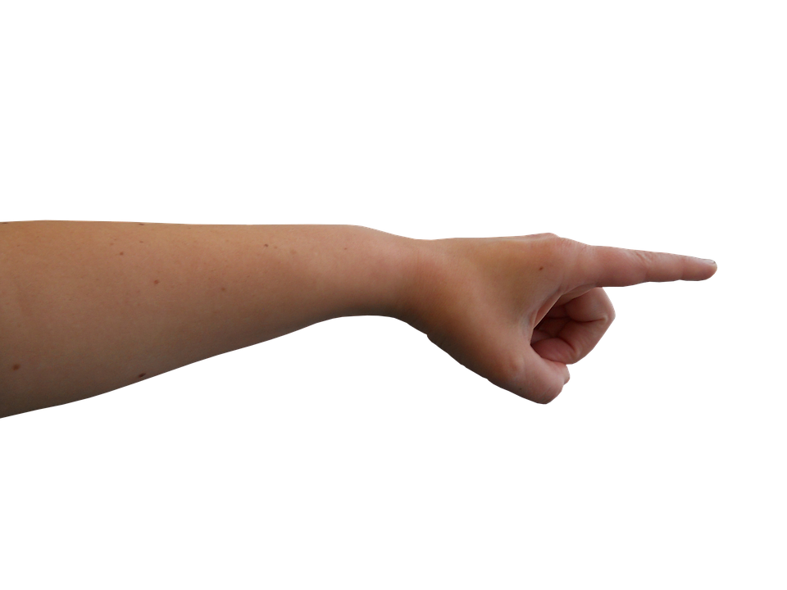

Introduction
Visual memory enables users to save images of specific objects
Perform in-air gestures to highlight object to be saved
Associate voice phrase with visual memory to retrieve in the future
I really want to have those ficus ruby for my patio!

Slide 26
Interesting AR Ideas
Not appropriate for Samsung

Slide 27
VR Gene Simulation
Home

Slide 28
Introduction
Allow kids to visually explore gene sequences using AR headset
Ability to modify gene sequences and see outcomes in real-time
E.g., modify gene for hair color and see how small changes in gene sequences can lead to different hair colors
Use gestures powered by wearable sensors to manipulate gene representation

Slide 29
Life History
Home

Slide 30
Introduction
Inspired by games such as Assassin’s Creed create an immersive history experience for kids that lets them interact with a virtual history simulation
Utilize VR headsets to create a living breathing world that kids can interact with
Kids could relive pivotal moments in human history to learn about what happened
Collaborative mediated learning experience with classmates and teacher
Ideal for people in rural or remote areas

Slide 31
Supporting Elderly with Pet Care Using AR Glasses
Home

Slide 32
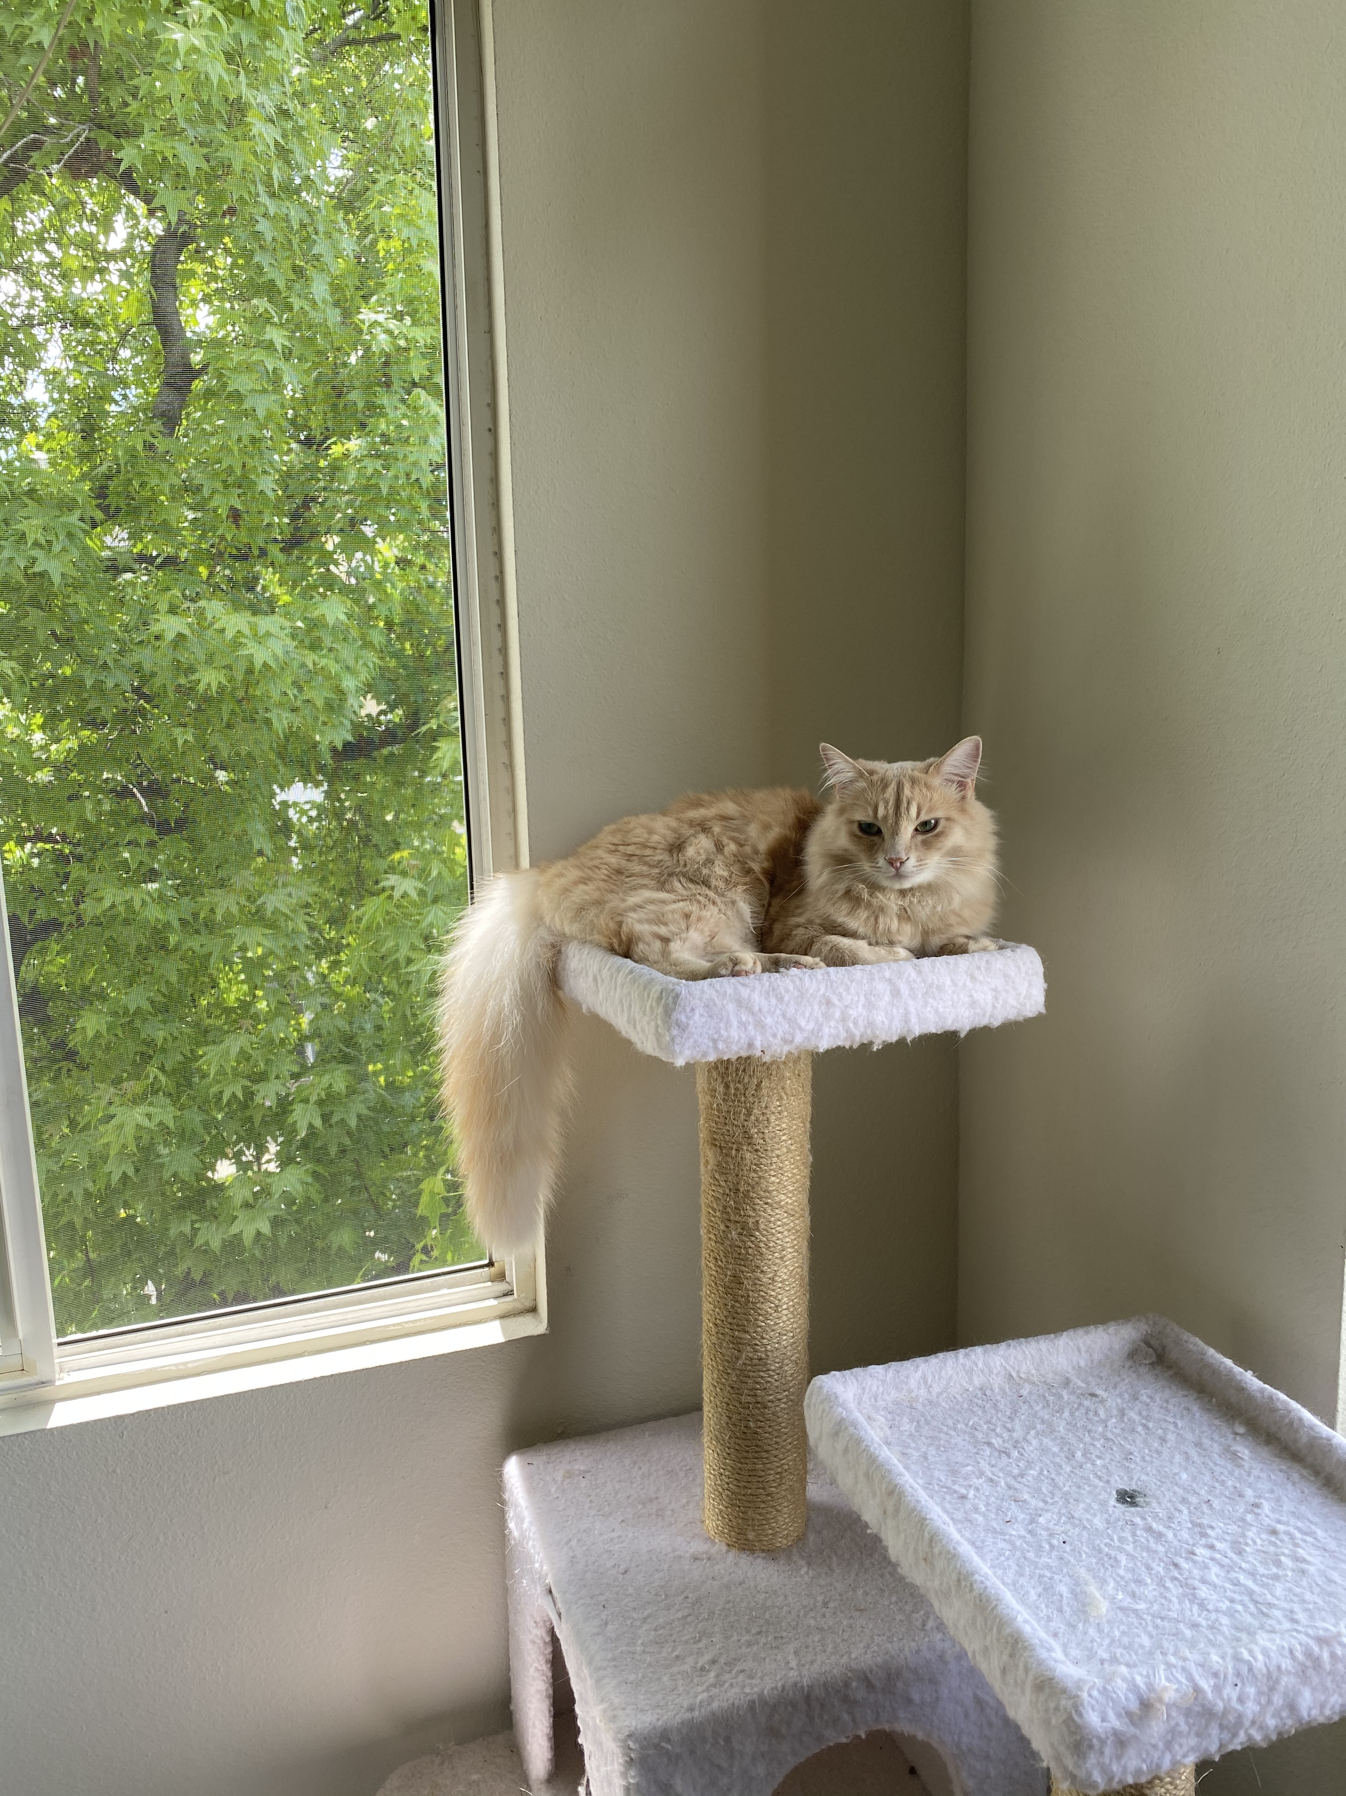

Introduction
Pets are an important emotional support for elderly people
Care of pets can be challenging due to cognitive decline
Support elderly by tracking vital information about a pet’s health
Physical activity
Body state
Time of last feeding
Interaction amount with pet
Display representation of pet status above pet when elderly person looks at the pet

Slide 33
Seamless Visual Search Using AR Glasses
Home + Mobile

Slide 34

Introduction
Visual search is a powerful concept to find information (or similar objects) about an object the user currently looks at
Current implementations in Google Lens require users to perform a series of explicit steps in order to perform a search
Perform visual search by using in-air gestures to identify what to search for OR
Use voice input to describe a visual object that is being shown in AR

Slide 35
Paper Ideas
Comprehensive comparison of different AR input techniques
Analysis of security enhancements through AR interaction based on gesture or voice
Development of new or improved interaction method

Slide 36
Appendix
Other Project Ideas

Slide 37
Intelligent Pill Management for the Elderly
Home

Slide 38
Introduction
Current state
Pain points & problems
Proposed solution

Slide 39
Current state
Due to the recent outbreak of COVID-19, it has put the elderly and senior citizen at a higher risk. As self-isolation and quarantine become the norm to reduce the spread of the outbreak, it has been strongly recommended globally.
As a consequence, it has become harder for senior citizen to replenish their prescription medication and keeping track of them during these difficult times.
Studies show that 87% of seniors take one prescription drug, 36% take 5 or more, and 38% use over-the-counter medications. (https://www.uptodate.com/contents/drug-prescribing-for-older-adults)
Furthermore, taking the correct dosage and type of medication correctly is crucial for treating their conditions.

Slide 40
Pain points & problems
Currently, if a person wishes to replenish their prescription medication during lockdown, they may:
Call-in in advance so the pharmacy can prepare the medication and leave it at the counter to avoid any person-to-person contact following the CDC guidelines (https://www.cdc.gov/coronavirus/2019-ncov/hcp/pharmacies.html?fbclid=IwAR3iN830jGJl9nL4ZC_3-6oYqtfBb_uJGkaQK1bzupq-sMnFluKJnIkTACI).
The patient may utilize different apps and pill management and delivery services.
Though these solutions may work for people at a lower risk of fatality when contracted with the virus, for senior citizens, this may be an inconvenience.
For instance, they might not feel comfortable going to a pharmacy in public when medicine is always in high demand.
Apps and different technologies might a challenge to use.

Slide 41
Details of Solution
A system that would notify the patient’s primary carer and clinician that the pill supply might be running low and is near the end of the prescription.
By strategically placing a set of smart home sensors or re-purposing existing home sensors to detect the act of taking medication or accessing the medicine drawer.
Once the primary carer or clinician is notified, they might inform the patient the next steps that could be taken or to set a delivery out to the patient.

Slide 42
Usage Scenario 1
Upon prescription, the clinician would have inputted the type of medication and dosage in the system. The system would recognize to detect the act of taking these set of pills within the patient’s home.
If patient A takes pill Z, pill X and pill Y: once, three and twice per day respectively for 3 weeks. The system will keep a count of times the pills have been taken and towards the end of the prescription timeline, the clinician will be notified for a check up with the patient.
If the medicine should be periodically taken, the clinician could set an order for a delivery to be put out to prevent the senior patient to leave the home.

Slide 43
Potential Challenges
Reliably detecting the action of taking multiple pills and keeping track of the timeline might be a challenge.
The data gathered within a home tied with the patient’s prescription history could is highly sensitive data.
Sensor installation might be hurdle, potentially a solution using the patient’s phone?

Slide 44
Pet Fitness and Health Tracking
Home

Slide 45
Introduction
Pets physical and mental health can be negatively impacted by owners being present during shelter-in-place
Even beyond current situation exercise and physical activity are important indicators for the health of a pet
Use body worn sensors to track and visualize a pets physical activity and body condition allowing owners to spot abnormal behavior and body state

Slide 46
Automation Suggestion for Smart Homes
Home

Slide 47
Introduction
Through instrumentation of home record and analyze normal patterns of occupants behavior
Recommend intelligent short cuts to help users
Example:
User has the following action sequence: at night before going to bed user shuts down blinds, locks front door and patio door, turns off automatic litter box, and finally turns off lights
System recognizes this action sequence and suggest smart default that reduces the burden for the user

Slide 48
Indoor Tracking and Path Optimization for Grocery Stores
Mobile

Slide 49
Introduction
Social distancing restrictions in super markets delay shopping trip and reduces number of people that can effectively shop on any given day
Even beyond current situation shopping trips can be substantially delayed during times of increased foot traffic
Solution
Use indoor tracking technology to see where a shopper is and create congestion maps for user
When paired with shopping list optimize route so that people can quickly finish their shopping trip and leave the store
Use voice interaction to add new items to list or allow user to find item they’re looking for

